Slide 1
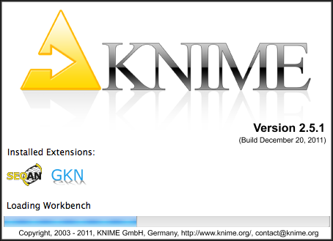
Workflows in KNIME with SeqAn
SeqAn – BioStore Workshop 2012

Slide 2
RazerS3
Read Mapper based on string filter. Weese, D., Holtgrewe M., & Reinert, K. (2012). RazerS 3: Faster, fully sensitive read mapping. Bioinformatics, in press, doi:10.1093/bioinformatics/bts505
Input
Genome FASTA Files, Reads FASTQ/FASTA Files
Output
Read Alignment File (e.g. in SAM format)

Slide 3
What Do We Want To Do?
Map reads to a genome
Visualize statistics
Classical Approach
Workflow Approach
Manually call tools
Error prone
Automatically call tools using bash/perl/python/...
In both cases
Visualization by Excel, R, gnuplot
Workflow engines allow for
Graphical scripting
Easy integration of different libraries
Easy visualization of data
Goal: SeqAn in KNIME

Slide 4
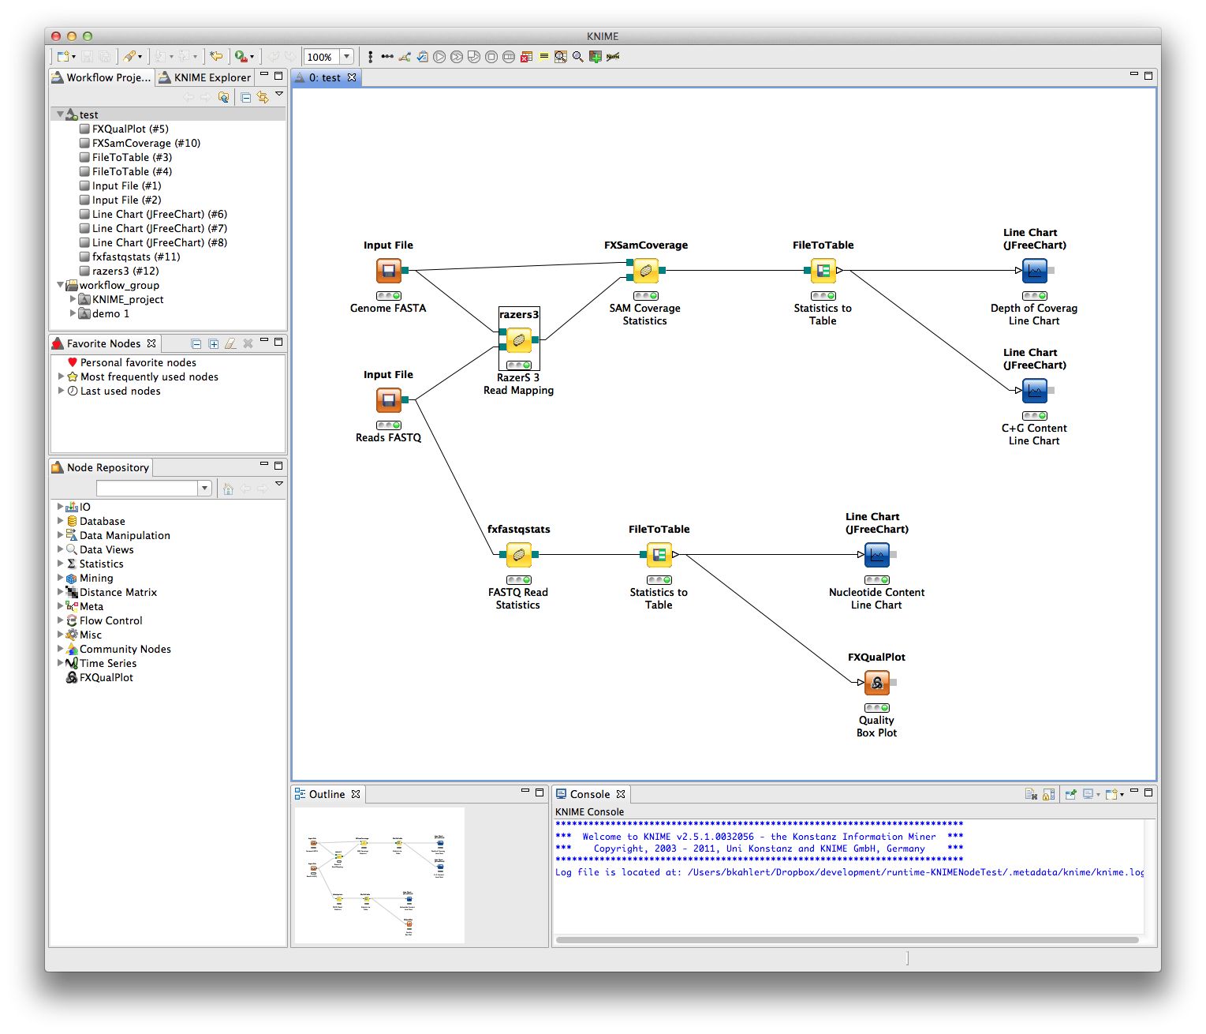
Demo Workflow

Slide 5


How it works...
Node Generator
./tool --write-ctd
CTD
CTD
CTD
Notes:
SeqAn apps
Generate CTDs using write-ctd argument
Both serve as input for the Node Generator
Optionally consumes further resources like icons
Generated plugin

Slide 6
How it works...
for each SeqAn app (in general: each binary) a ctd file is generated
[ctd snippet]
GenericWorkflowNodes generates a two plug-ins out of the ctd (and other meta files)
Plug-in #1
Base Plug-in
Core functionality
Always the same – no matter what ctd files you process
Plug-in #2
Meta information and Java code for KNIME
Documentation
Graphics
Optional binaries
Copy the two plug-in in the plugins directory of your KNIME installation
If no binaries included, need to set in preferences

Slide 7
Custom Nodes
Issue:
Solution: New Node FASTQ Read Statistics
We want to extract some statistics from the FASTQ file.
There‘s no node for this.
Small SeqAn app
Input
FASTQ file with Illumina Reads
Output
TSV file with statistics
For each position, compute statistics on qualities (mean, median, ...) and nucleotide content (percentage C, G, A, T, N).
Notes:
What if KNIME does not provide the needed node?

Slide 8
How To Write Custom Nodes...
Can be any kind of command line program in any language!
Fancy
App
Cool
App
Great
App
Node Generator
./tool --write-ctd
CTD
CTD
CTD
Notes:
Notes:
If you implement your tool with SeqAn you automatically benefit from the Argument Parser!
Otherwise CTD must be handwritten
Futher details in App Session 4
(details on Argument Parser)

Slide 9
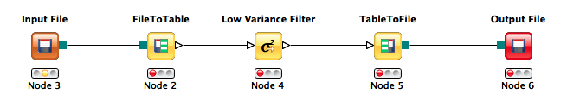
File-based vs. Table-based nodes
Originally, KNIME is designed for statistical data from finance, biomedical, and chemical applications (less than 100MBs of data).
Data is stored in tables and processed in Java.
For NGS data, we would like to be able to process 100GBs of data and not be limited to Java but also use C/C++ (or virtually any command line) tool.
Data should stay in files. Primary data analysis works on plain files, without any enforcement of abstractions, yielding 100MBs of data from 100GBs of data.
Secondary analysis of NGS data can then be in KNIME, leveraging the large number of existing nodes.
Conversion nodes available for many file types.
Notes:
Further issue: How to make the statistics file usable for other KNIME nodes?

Slide 10
Roadmap
Make all SeqAn apps KNIME compatible
Availability through Eclipse Update Site
Platform-specific plugins (e.g. only for Linux + x64)
Submit jobs to compute clusters directly from KNIME

Slide 11
Questions?

